Slide 1

Detecting Phishing Domains with Machine Learning
Madhav Rana
Vivek Surati
Krunal Rathod
Harsh Rana
Rudra Pithawa
College : RNGPIT

Slide 2




Understanding the Phishing Threat
What is Phishing?
Phishing is a cyberattack using deceptive websites or emails to trick users into revealing sensitive information, like passwords or credit card numbers.
A Growing Concern
It's an escalating problem in cybersecurity. Traditional defenses, like blacklists, are easily bypassed by newly generated, malicious domains.
Our Solution
We aim to leverage machine learning to automatically detect phishing domains by analyzing unique features extracted directly from URLs and domain names.

Slide 3

The Challenge: Deceptive Imitation
Many phishing domains are crafted to closely mimic legitimate ones, making them hard to distinguish. For instance, paypa1.com is designed to look like paypal.com.
This deceptive imitation makes it easy for users to fall victim. The constantly evolving nature of these attacks means manual detection or static rule-based systems are often inadequate.
Our objective is to build an intelligent system capable of automatically detecting these sophisticated phishing attempts using AI models.

Slide 4




Our Machine Learning Approach
Our detection system frames the challenge as a binary classification problem: identifying domains as either "phishing" (1) or "not phishing" (0).
Feature Extraction
We extract key features from domain names, such as length, character patterns, presence of hyphens, and suspicious keywords.
Model Training
These features are then fed into machine learning models, which are trained on labeled data to recognize patterns indicative of phishing.
Classification Output
The models learn to classify domains, providing a robust, automated detection mechanism.

Slide 5
Dataset for Training and Validation
Our model was trained and validated using a comprehensive dataset of 10,000 URLs, sourced from a combination of public repositories (e.g., Kaggle) and custom-collected phishing domain lists.
Total Samples
10,000 URLs (5,000 phishing, 5,000 legitimate)
Key Features
URL length, presence of "@" symbol, subdomain count, numerical characters, specific keywords
Target Column
"label": 1 (phishing) or 0 (legitimate)

Slide 6
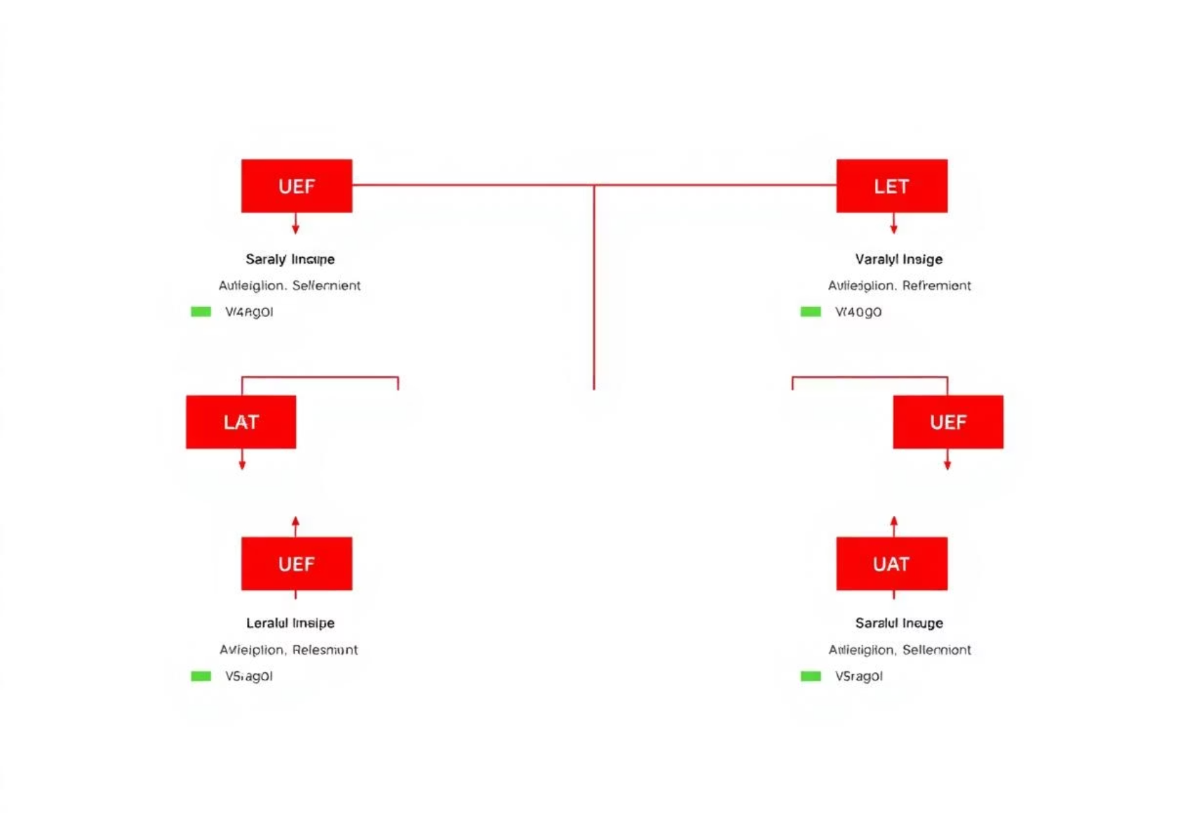

Algorithms Employed
Decision Tree
Random Forest
This model segments data based on feature conditions, like detecting phishing if a URL length exceeds 60 characters. It's straightforward to interpret and visualize, but can sometimes overfit to training data, reducing generalization.
An ensemble of multiple decision trees, each trained on a unique subset of the data. Predictions are determined by majority vote from all trees. This approach typically offers higher accuracy and is more robust against overfitting than a single decision tree.

Slide 7

Rigorous Preprocessing Steps
Before feeding data into our models, several critical preprocessing steps were performed to ensure data quality and model readiness.
Data Cleaning
Removing null values and correcting any invalid or inconsistent data entries.
Feature Engineering
Transforming raw domain names into quantifiable features, such as the count of special characters, digits, or suspicious patterns.
Data Splitting
Dividing the dataset into training and testing sets to objectively evaluate model performance on unseen data.
Optional Scaling
Applying feature scaling for models sensitive to the magnitude of feature values, though less critical for tree-based algorithms.

Slide 8
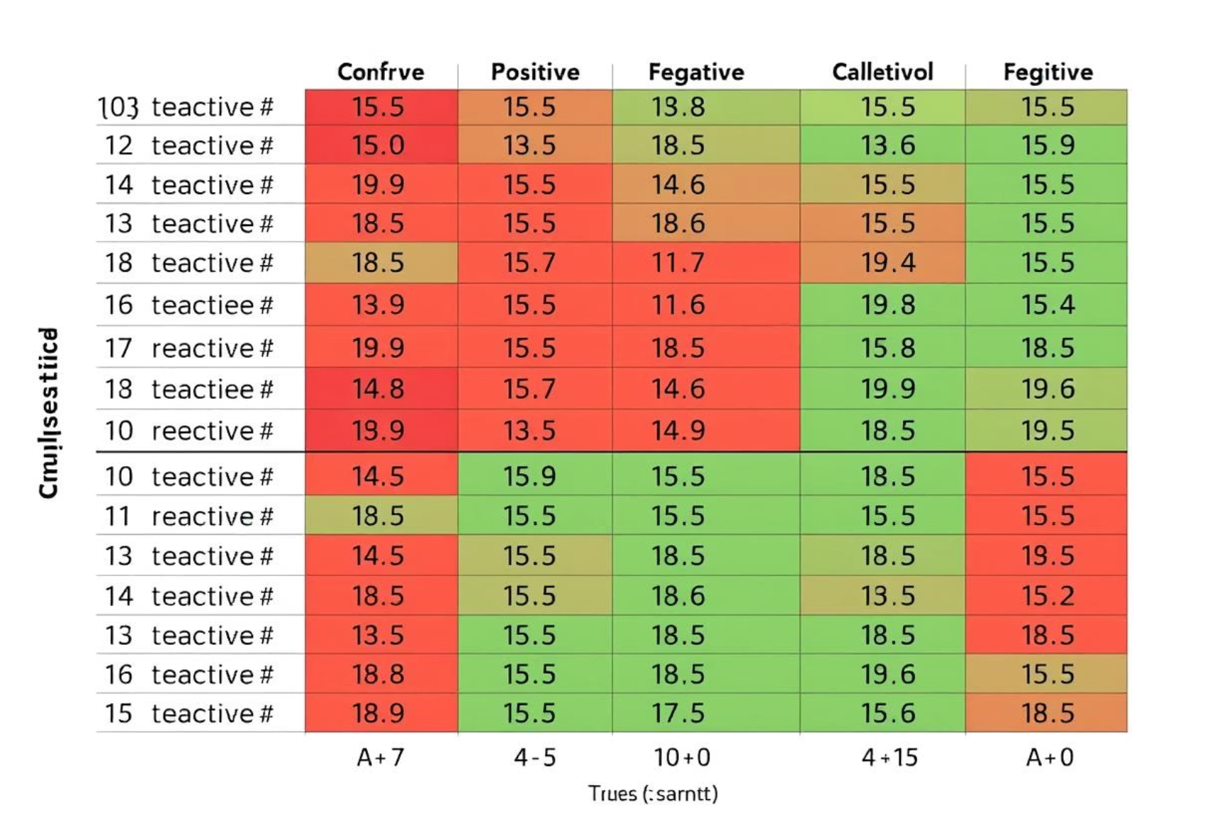
Model Training & Evaluation
Both Decision Tree Classifier and Random Forest Classifier models were built using scikit-learn. Their performance was rigorously evaluated using key metrics.
Key Metrics
Confusion Matrix
Accuracy: Overall correct predictions made by the model.
This matrix visually represents the number of true positives, true negatives, false positives, and false negatives, indicating misclassifications.
Precision: The percentage of predicted phishing domains that were actually phishing.
Recall: The percentage of actual phishing domains that were correctly detected.
F1-score: A balanced metric combining precision and recall, crucial for imbalanced datasets.

Slide 9
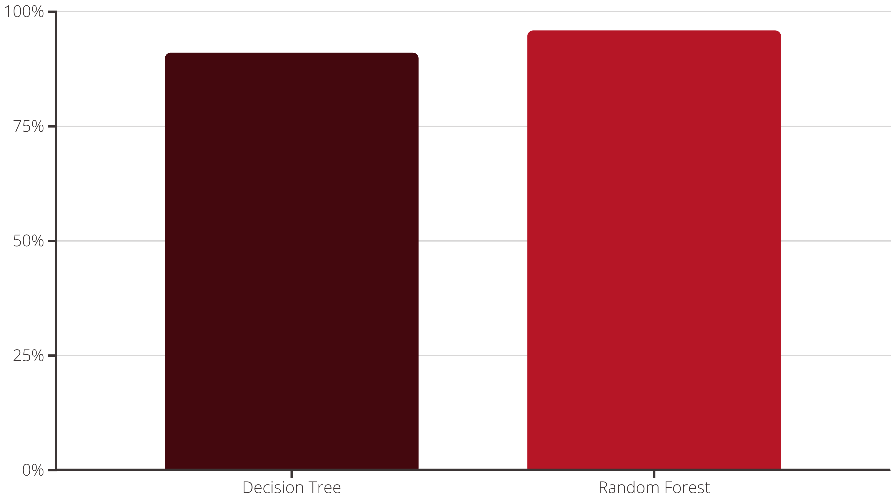
Performance Comparison: Decision Tree vs. Random Forest
A direct comparison reveals the superior performance of the Random Forest model in detecting phishing domains.
Random Forest consistently outperforms a single Decision Tree, boasting higher accuracy and better generalization capabilities. This is primarily due to its ensemble nature, which reduces overfitting by aggregating predictions from multiple trees, each trained on different data subsets and feature considerations.

Slide 10

Key Findings & Future Outlook
1
Random Forest Reliability
2
Indicative Features
3
Adaptability of ML Models
Specific URL features, such as the presence of "@" symbols, "//" sequences, IP addresses in the domain, or unusually long subdomains, are strong indicators of phishing attempts.
The Random Forest model emerges as a highly reliable and robust solution for automated phishing detection due to its superior accuracy and generalization.
Unlike static, rule-based systems, machine learning models can effectively generalize and adapt to detect novel and evolving phishing domains, providing a dynamic defense.

Slide 11
Conclusion
Machine learning presents a powerful and adaptable approach for detecting evolving phishing domains.
While Decision Trees offer interpretability, Random Forest models consistently demonstrate superior performance and generalization capabilities, effectively mitigating overfitting.
This robust machine learning methodology can be seamlessly integrated into various security applications, including web browsers, email filters, and website firewalls, to provide dynamic and effective defense against phishing attacks.

Slide 12
Future Work & Enhancements
Incorporate additional features, such as SSL certificate validation and DNS information, to enrich the dataset.
Explore the application of deep learning models, specifically LSTMs, for sequence-based URL detection to improve accuracy.
Develop a real-time phishing detection tool, potentially as a browser extension or API, for immediate threat identification.
Establish a regular process for updating and retraining the model with new data to maintain its effectiveness against evolving phishing techniques.

Slide 13
References
This section provides a comprehensive list of resources and tools utilized in this project:
The source link for the dataset used for training and validation.
Python libraries leveraged, such as sklearn, pandas, and others.
Any relevant academic papers, articles, or blog posts that informed the methodology.

